Slide 1


Social Buzz’s Analysis

Slide 2


Today's agenda
Project recap
Problem
The Analytics team
Process
Insights
Summary

Slide 3

Social Buzz is a fast growing technology unicorn that need to adapt quickly to its global scale. Accenture has begun 3 month POC focusing on this tasks :
An audit of Social Buzz’s big data practice
Recommendations for a successful IPO
An analysis to find Social Buzz’s top 5 most popular categories of content
Project Recap

Slide 4

Problem
Over 100000 posts per day
36,500,000 pieces of content per year!
But how to capitalize on it when there is so much ?
An analysis to find Social Buzz’s top 5 most popular categories of content

Slide 5



Andrew Fleming
Chief Technology Architect
The Analytics team
Marcus Rompton
Senior Principle
Mayur Santosh Dalvi
Data Analyst

Slide 6
Process
Data Understanding
1
Data Cleaning
2
3
Data Modeling
4
Data Analysis
5
Uncover insights

Slide 7

Insights
16
1897
May
Reactions for ‘animals’
category
Month is having 2138
Posts
Unique Categories

Slide 8
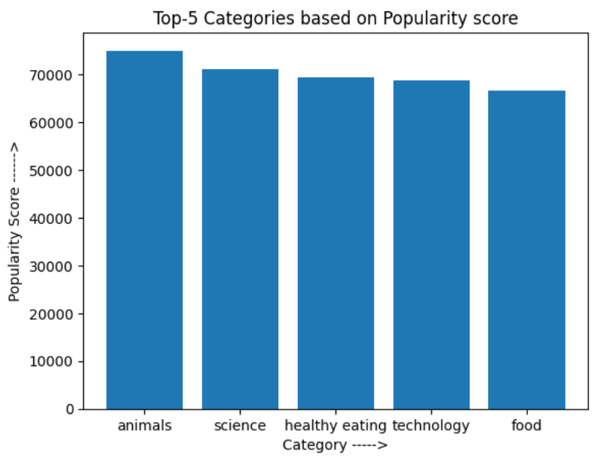
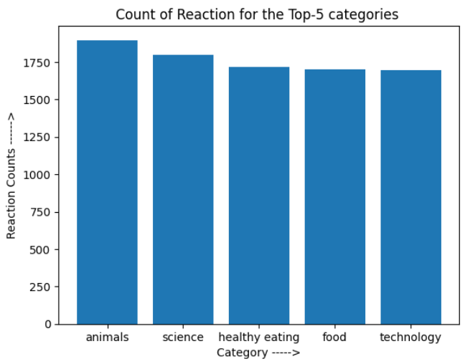

Slide 9
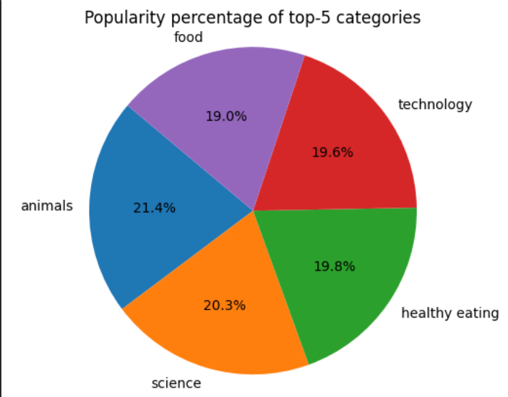
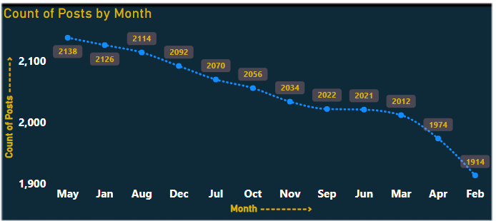

Slide 10

ANALYSIS
Animals are the most popular category, followed by science, healthy eating, technology and food.
INSIGHTS
Peoples love for adorable animals are showing in the results.
With all the fascinating things like Chat GPT, AI buzz around, people are more interested in the new things happening in Science and Technology world.
One of the basic needs, Food is in the top list. Also people have become more conscious about their health and interested in knowing healthy foods habits.
Social Buzz can use the above insights and campaign accordingly with brands to increase the user engagement
Summary
NEXT STEPS
This ad-hoc analysis is insightful, but it’s time to take this analysis to large scale production for real time understanding of your business. We can help you achieve this.

Slide 11
Thank you!
ANY QUESTIONS?

